Slide 1
Chapter 18
Concurrency Control Techniques
Copyright © 2007 Ramez Elmasri and Shamkant B. Navathe

Slide 2
Database Concurrency Control
Two-Phase Locking Techniques Binary:
  Locking is an operation which secures
    (a) permission to Read
    (b) permission to Write a data item for a transaction.
  Example:
    Lock (X). Data item X is locked in behalf of the requesting transaction.
  Unlocking is an operation which removes these permissions from the data item.
  Example:
    Unlock (X): Data item X is made available to all other transactions.
  Lock and Unlock are Atomic operations.
Slide 18- <number>

Slide 3
Database Concurrency Control
Two-Phase Locking Techniques: Essential components
  Two locks modes:
    (a) shared (read) (b) exclusive (write).
  Shared mode: shared lock (X)
    More than one transaction can apply share lock on X for reading its value but no write lock can be applied on X by any other transaction.
  Exclusive mode: Write lock (X)
    Only one write lock on X can exist at any time and no shared lock can be applied by any other transaction on X.
Slide 18- <number>

Slide 4
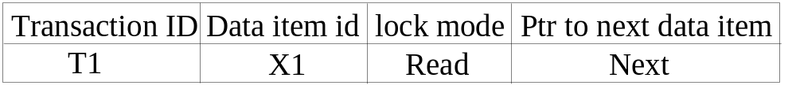
Database Concurrency Control
Two-Phase Locking Techniques: Essential components
  Lock Manager:
    Managing locks on data items.
  Lock table:
    Lock manager uses it to store the identify of transaction locking a data item, the data item, lock mode and pointer to the next data item locked. One simple way to implement a lock table is through linked list.
Slide 18- <number>

Slide 5
Database Concurrency Control
Two-Phase Locking Techniques: Essential components
  The following code performs the unlock operation:
  LOCK (X) ← 0 (*unlock the item*)
  if any transactions are waiting then
  wake up one of the waiting the transactions;
Slide 18- <number>

Slide 6
Database Concurrency Control
Two-Phase Locking Techniques: Essential components
Lock conversion
  Lock upgrade: existing read lock to write lock
if Ti has a read-lock (X) and Tj has no read-lock (X) (i ≠ j) then
  convert read-lock (X) to write-lock (X)
  else
  force Ti to wait until Tj unlocks X
  Lock downgrade: existing write lock to read lock
  Ti has a write-lock (X) (*no transaction can have any lock on X*)
  convert write-lock (X) to read-lock (X)
Slide 18- <number>

